Slide 1
Expert-level detection of pathologies from unannotated chest X-ray images via self-supervised learning

Slide 2
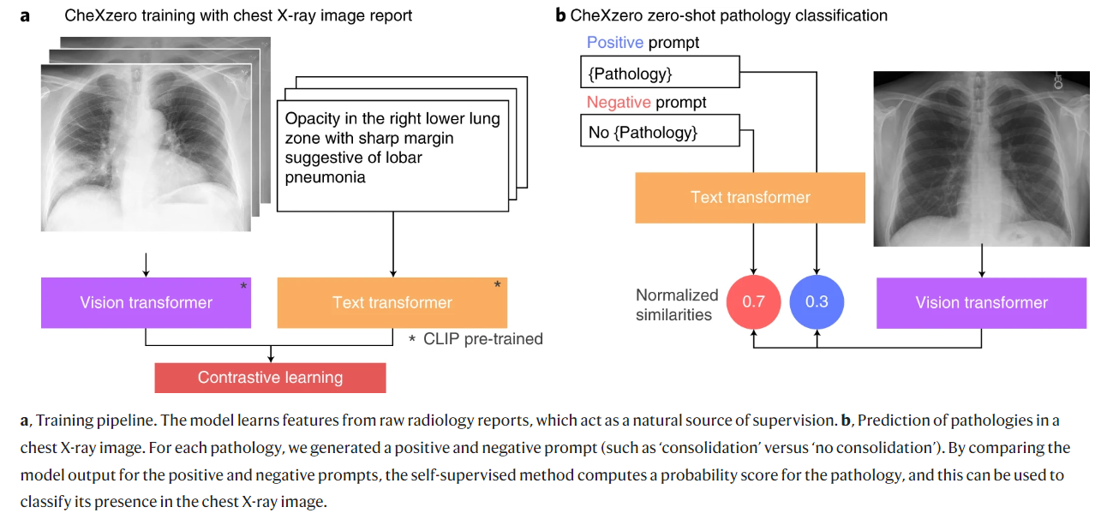
Methods

Slide 3
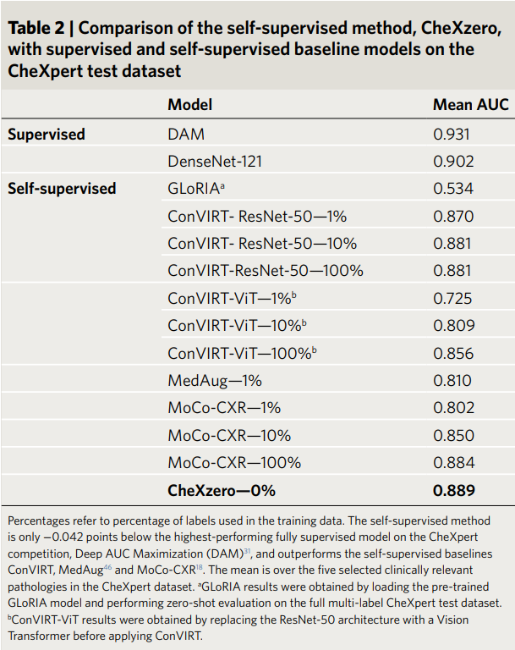
Results

Slide 4
The idea is interesting, but…
We already have NLP labelers, such as CheXpert and NegBio, that can extract labels from text reports. By using those labelers. The label generation will only take one run, which saves the training time.
A pretrained Text Transformer is still needed in training (the vector for each class can be stored for inference).In terms of performance, it is not better than using labelers.
Radiologists do not need to manually annotate CXRs when using labelers. Both require report text + CXRs for classification.
This idea would be beneficial if it came out before those labelers. Once the labelers have been developed, this approach is unnecessary.

